Slide 1
TWT AI MASTERY PROGRAM . CAPSTONE PROJECT · PROOF OF CONCEPT
AI Powered Release Note Workflow
Transforming Source Data into Publication-ready Documentation
05 July 2026
Bhargavi

Slide 2



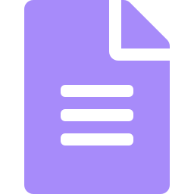

01 CONTEXT
Business Challenge
Fragmented Sources
Manual & Time-Consuming
Release information is scattered across multiple source systems and implementation notes.
Manual release notes creation is repetitive and time-consuming
Heavy Review Loops
Publication Overhead
Multiple review passes multiply the documentation effort per release.
Extra manual formatting is needed to make notes publication-ready.
OBJECTIVE Automate the end-to-end release-note workflow while ensuring quality, consistency, and publication standards.
02

Slide 3






02 APPROACH
AI-Powered Solution
Source Data +
Impl. Notes
Release Data
Extractor
Release Note
Generator
Publication-Ready
Release Note
Release Note
Publisher
Release Note
Reviewer
AI SKILLS
Release Data Extractor
Release Note Generator
Release Note Reviewer
Release Note Publisher
Human Review and Approval
03

Slide 4


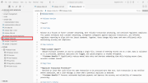
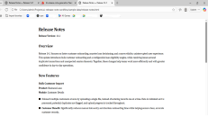


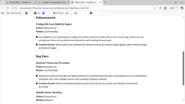
03 DEMONSTRATION
End-to-End Workflow
01
02
03
Extract Source Data
Generate Release Note
Review Release Note
04
Publish Release Note
Human Validation -> Approval -> Publication
04

Slide 5
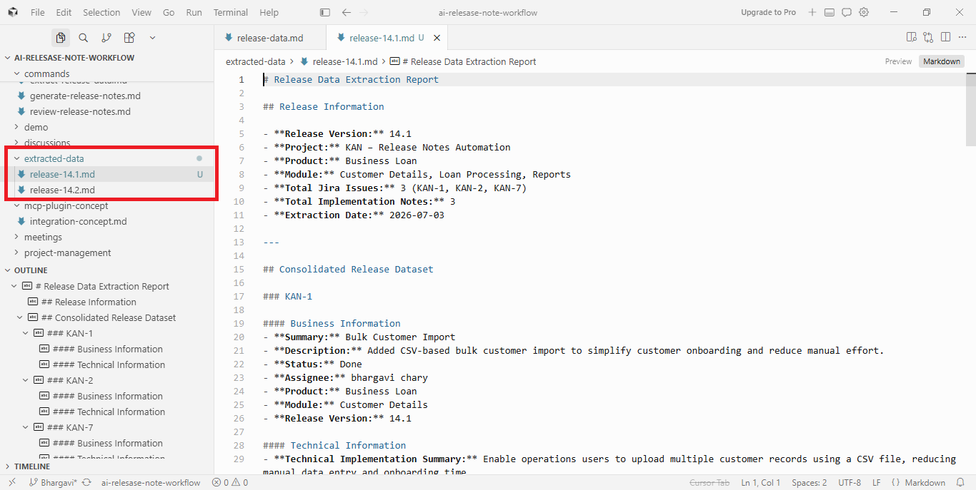

Slide 6
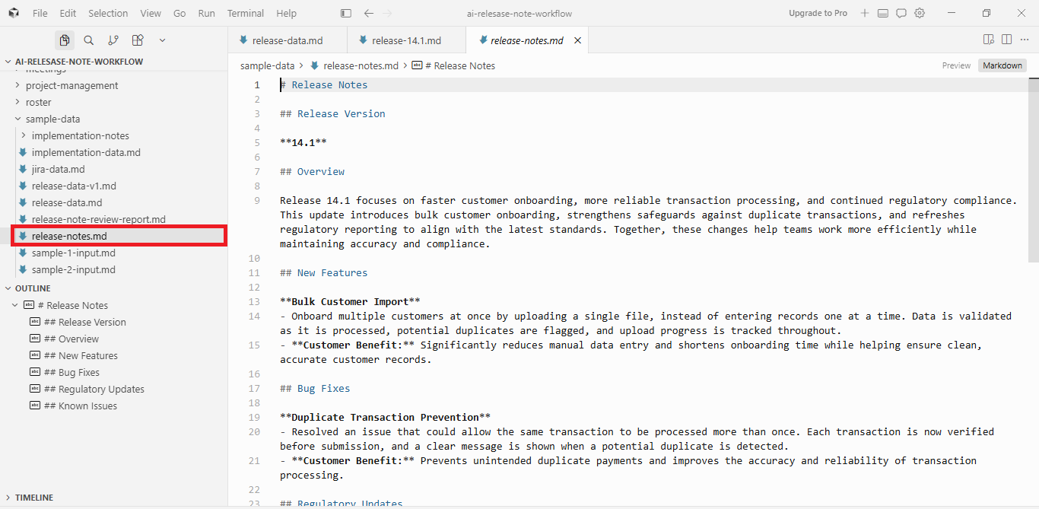

Slide 7
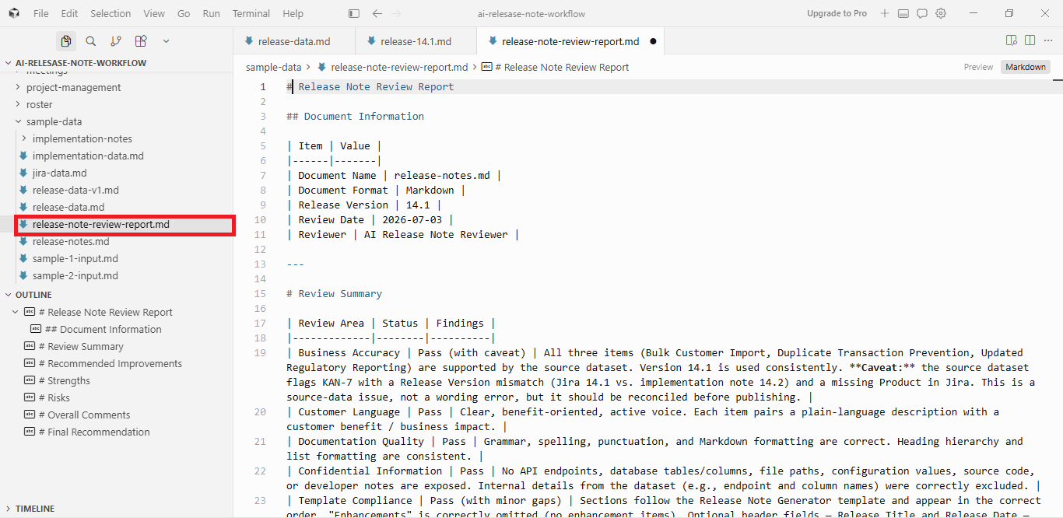

Slide 8
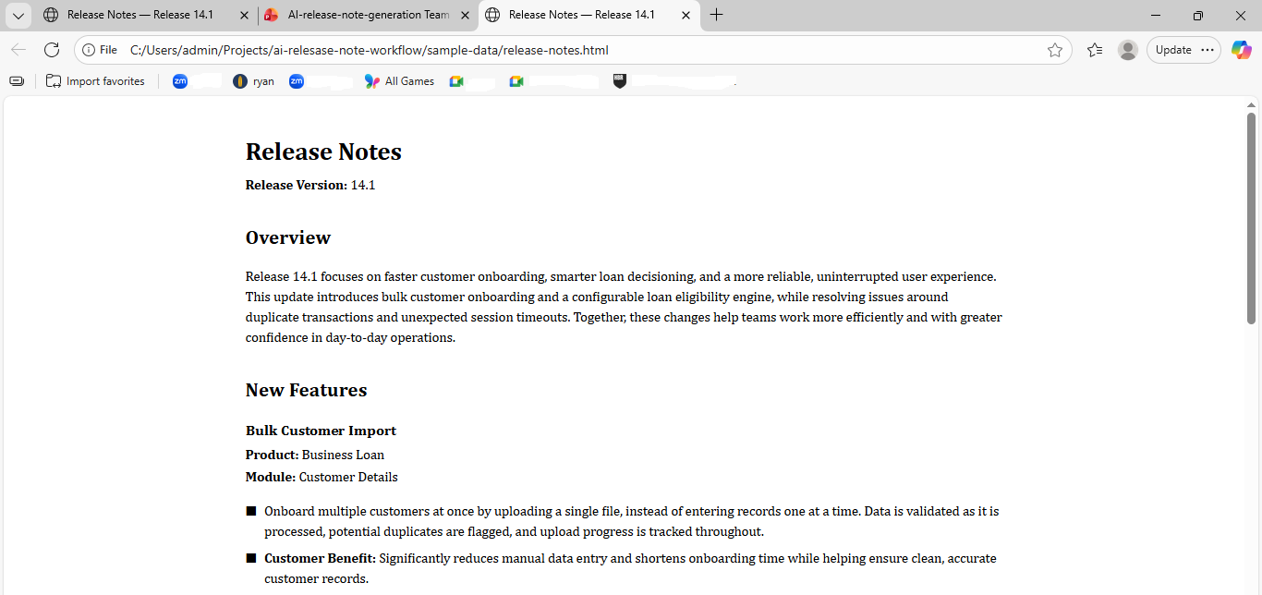

Slide 9
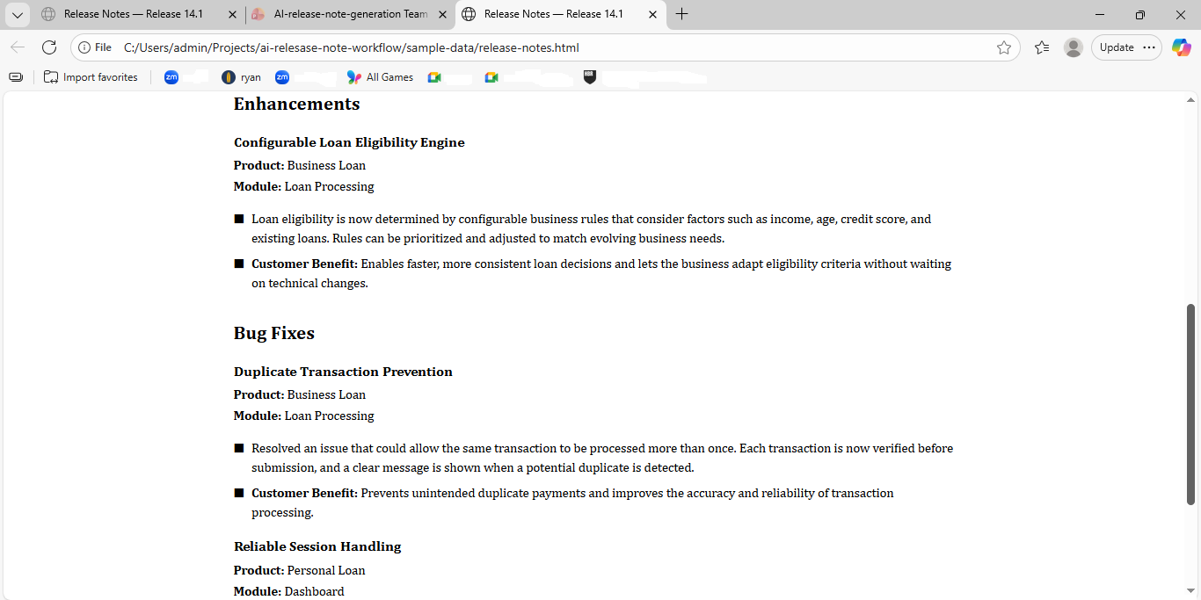

Slide 10





04 IMPACT
Business Value
Benefits
Reduced manual documentation effort in release note creation
Consistent and standardized release note generation
Faster documentation turnaround
Publication-ready outputs
Improved content quality through AI review
05

Slide 11
“This makes people faster,
not redundant.”
Bridging technical and business context to deliver customer-ready release notes
PROOF OF CONCEPT · CAPSTONE PROJECT
Bhargavi
Thank you

